Slide 1





Trends and Determinants of Poor Treatment Outcomes among Drug-Susceptible Tuberculosis Patients in Marsabit County—Kenya, 2019-2024
Guyati Halkano^{1,2},B.Waweru¹,A.Mwatondo^{1,3},S. Ibrahim¹,M. Owiny^{1,3}, J.Omolo⁵, R. Nyawa^{1,4}, J. Githuku^{1,3}
¹Kenya Field Epidemiology and Laboratory Training Program ²County Department of Health, Marsabit ³African Field Epidemiology Network ⁴Zoonotic Disease Unit, Kenya ⁵County Department of Veterinary Services, Kilifi
Public health interventions towards Universal Health Coverage
Kenya Health Security Convention | 5th – 8th May 2026 | Mombasa - Kenya

Slide 2
Background
  Kenya Context: High-burden setting for (TB, TB-HIV, MDR-TB) (WHO, 2024a)
  Geography: Marsabit’s vast arid terrain creates significant adherence barriers
  Mobility: Nomadic pastoralist lifestyles complicate patient follow-up
  There is limited data on the specific factors contributing to PTO in Marsabit County

Slide 3
Objectives
  Broad Objective
  Evaluate determinants of PTO among DSTB patients
  Specific Objectives
  Characterize socio-demographic and clinical characteristics of DSTB patients
  Analyze regional DSTB case notification trends
  To identify factors associated with PTO among DSTB patients

Slide 4
Methods: Study Design & Setting
  Study design: Retrospective cohort study
  Study area: Marsabit county (Saku, Laisamis, North Horr)
  Study population & Period: All registered DSTB cases 2019 – 2024
  Data Source: National TB Program electronic surveillance system -TIBU
  Definitions:
      Successful outcomes ─ cured & treatment completed
      Poor/Unsuccessful outcomes ─ died, moved to category 4(MT4), transfer out, Lost to follow up (LTFU)

Slide 5
Methods: Data Management & Analysis
  Ethical considerations: CO & CDH, data de-identified, confidentiality
Category | Details
Independent Variables | • Socio-demographics: age, sex, sub-county • Clinical: Diagnostic, TB type, patient type, comorbidities, HIV status, nutrition status
Dependent Variable | • Treatment Outcome
Descriptive Analysis | • Categorical: Frequencies and proportions
Inferential Analysis | • Bivariable: Chi-square test (Screening threshold p < 0.25) • Multivariable: Logistic Regression (p < 0.05, 95% CI)

Slide 6
Results: Characteristics of DSTB cases, Marsabit, 2019-2024
Variable | Category | Frequency (n) | Proportion (%)
Sex | Male | 1078 | 56.8
 | Female | 819 | 43.2
Age Group | 0-14 years | 152 | 8
 | 15-44 years | 1224 | 64.5
 | 45-64 years | 358 | 18.9
 | >65 years | 163 | 8.6
Nutritional Status | Undernourished | 1187 | 62.6
 | Normal | 454 | 23.9
 | Overweight | 169 | 8.9
 | Anomalies | 87 | 4.6
HIV Status | HIV Positive | 154 | 8.1
 | HIV Negative | 1618 | 85.3
 | Not Done | 125 | 6.6
Comorbidities | Present | 162 | 8.5
 | Absent | 1735 | 91.5

Slide 7
Results: Characteristics of DSTB cases, Marsabit, 2019-2024
Variable | Category | Poor Outcomes Frequency (%) | Successful Outcomes Frequency(%)
Sex | Male | 126(11.7) | 952(88.3)
 | Female | 64(7.8) | 755(92.2)
Age Group | 0-14 years | 10(6.6) | 142(93.4)
 | 15-44 years | 114(9.3) | 1110(90.7)
 | 45-64 years | 41(11.5) | 317(88.5)
 | >65 years | 25(15.3) | 138(84.7)
Nutritional Status | Undernourished | 117(9.9) | 1070(90.1)
 | Normal | 44(9.7) | 410(90.3)
 | Overweight | 12(7.1) | 157(92.9)
 | Anomalies | 17(19.5) | 70(80.5)
HIV Status | HIV Positive | 29(18.8) | 125(81.2)
 | HIV Negative | 149(9.2) | 1469(90.8)
 | Not Done | 12(9.6) | 113(90.4)
Comorbidities | Present | 45(27.8) | 117(72.2)
 | Absent | 145(8.4) | 1590(91.6)

Slide 8
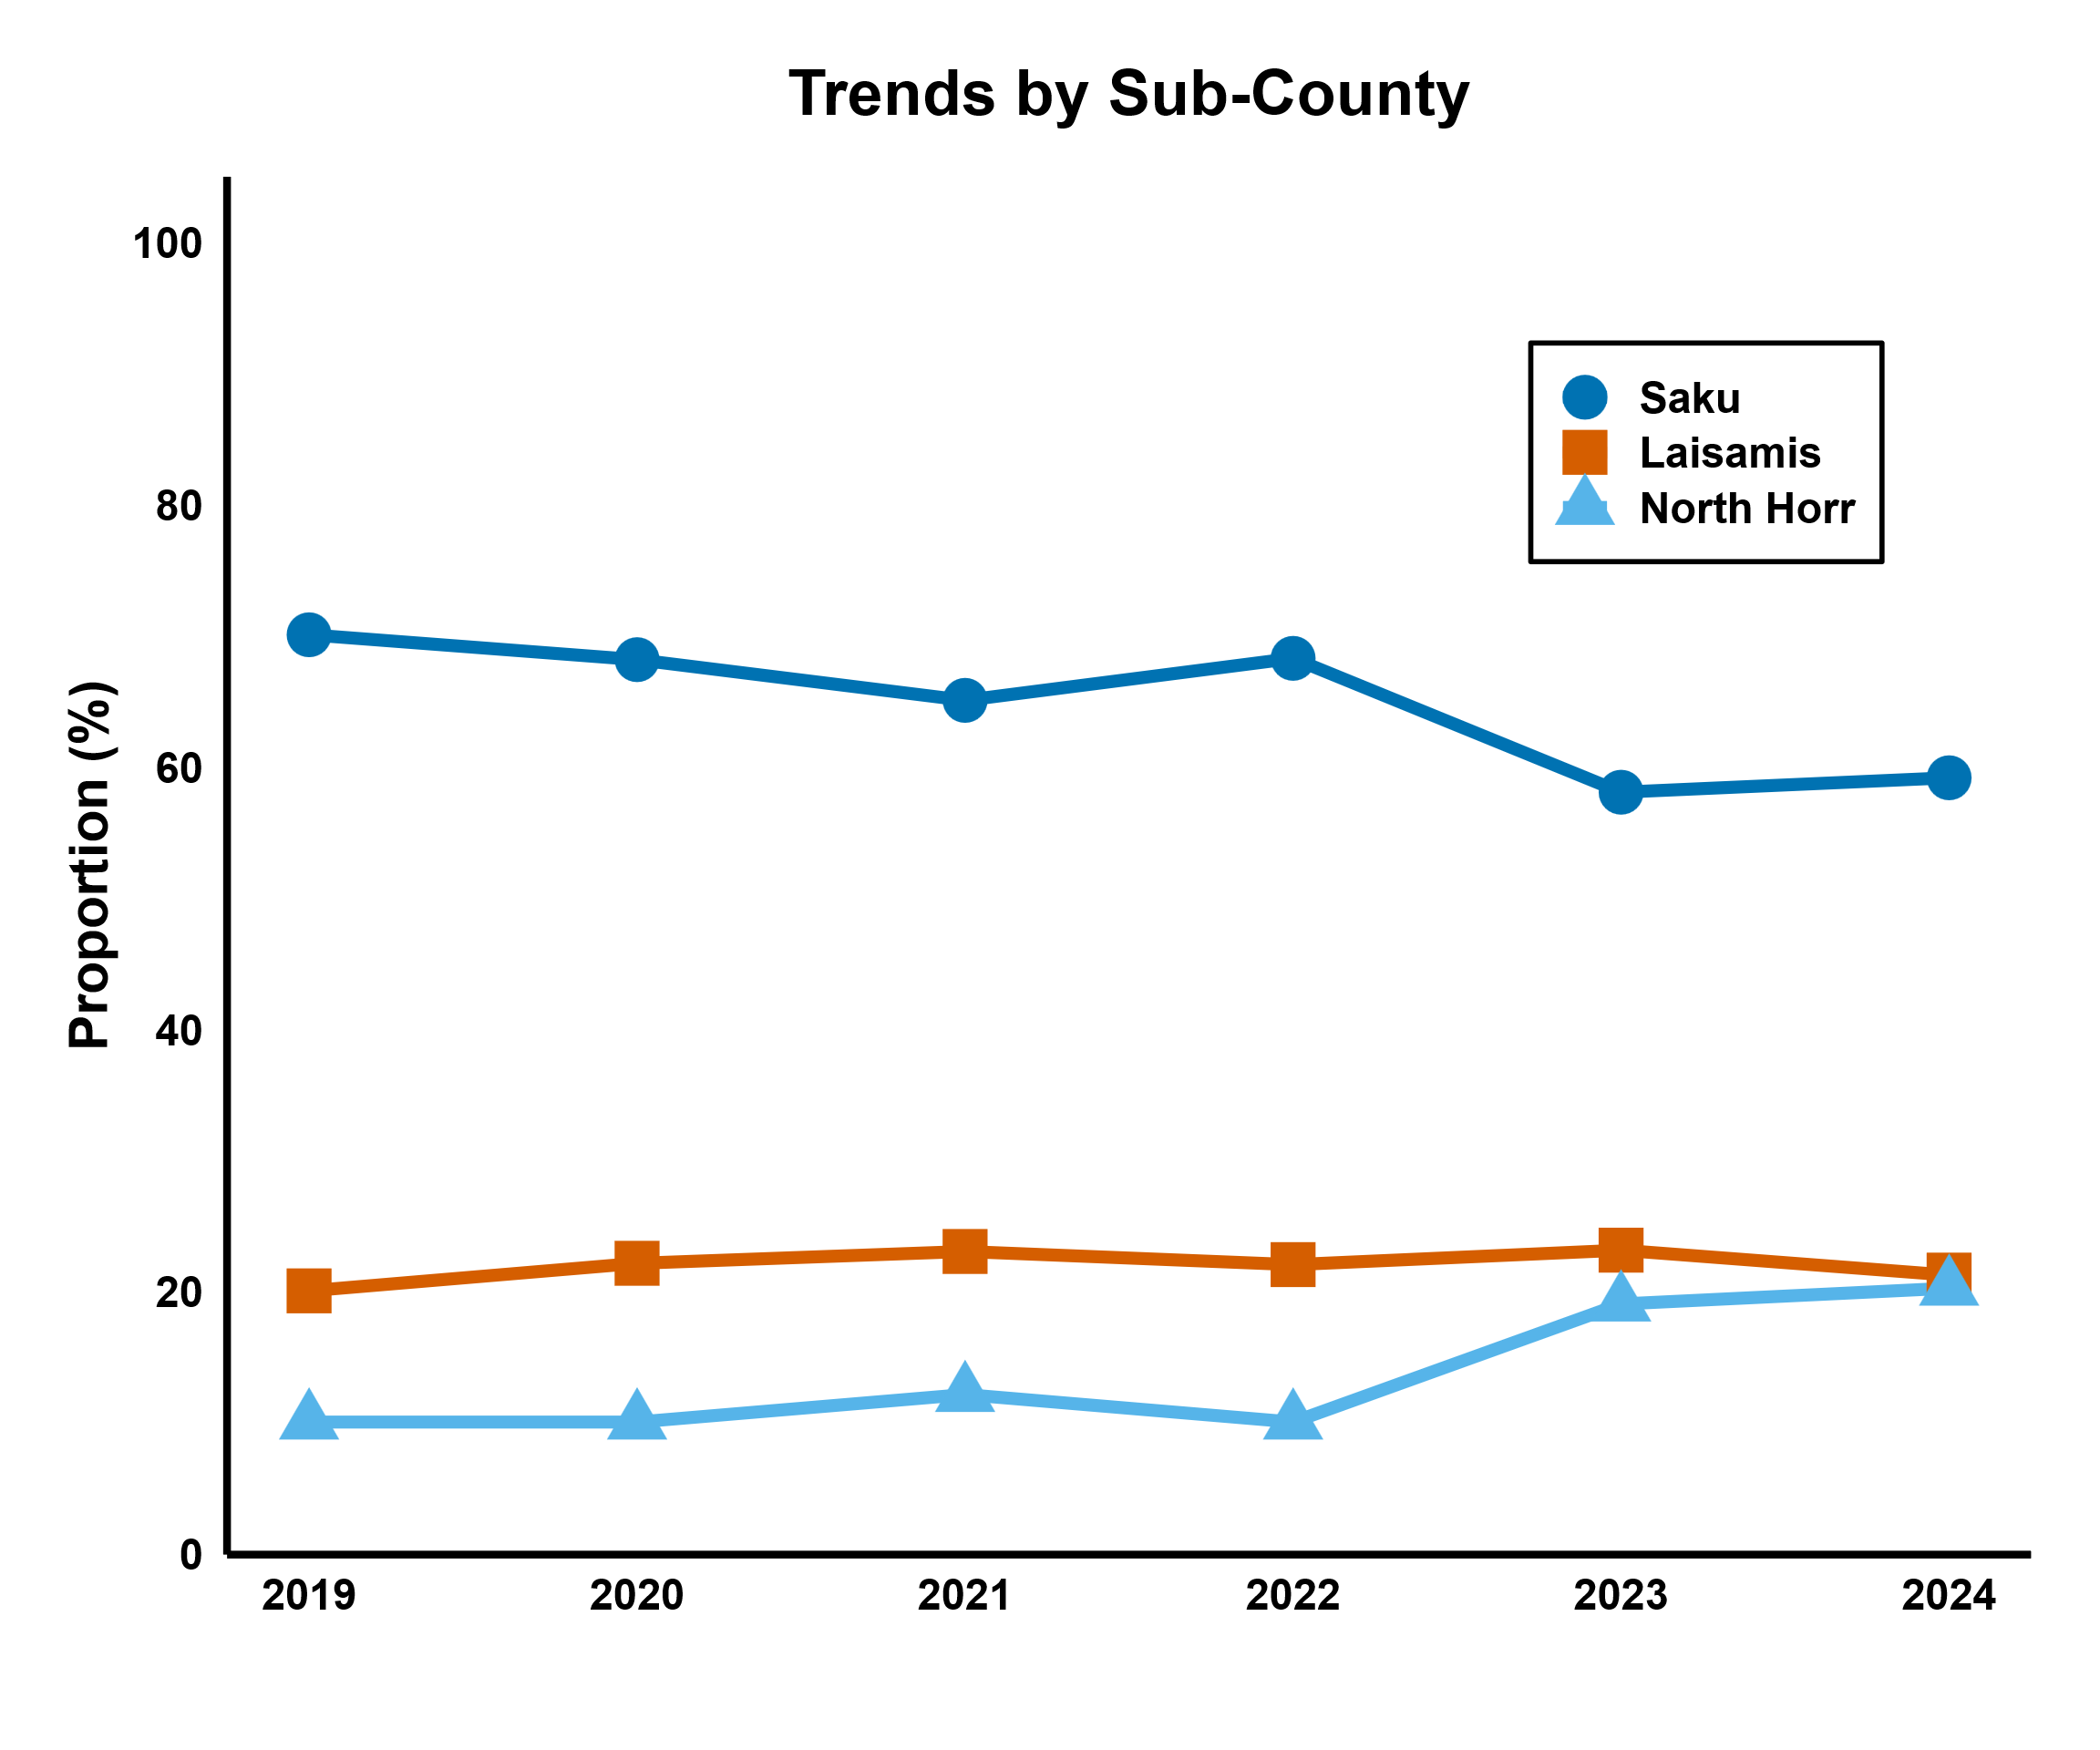
Results: DSTB Case notification Trends by Sub-County, 2019–2024

Slide 9
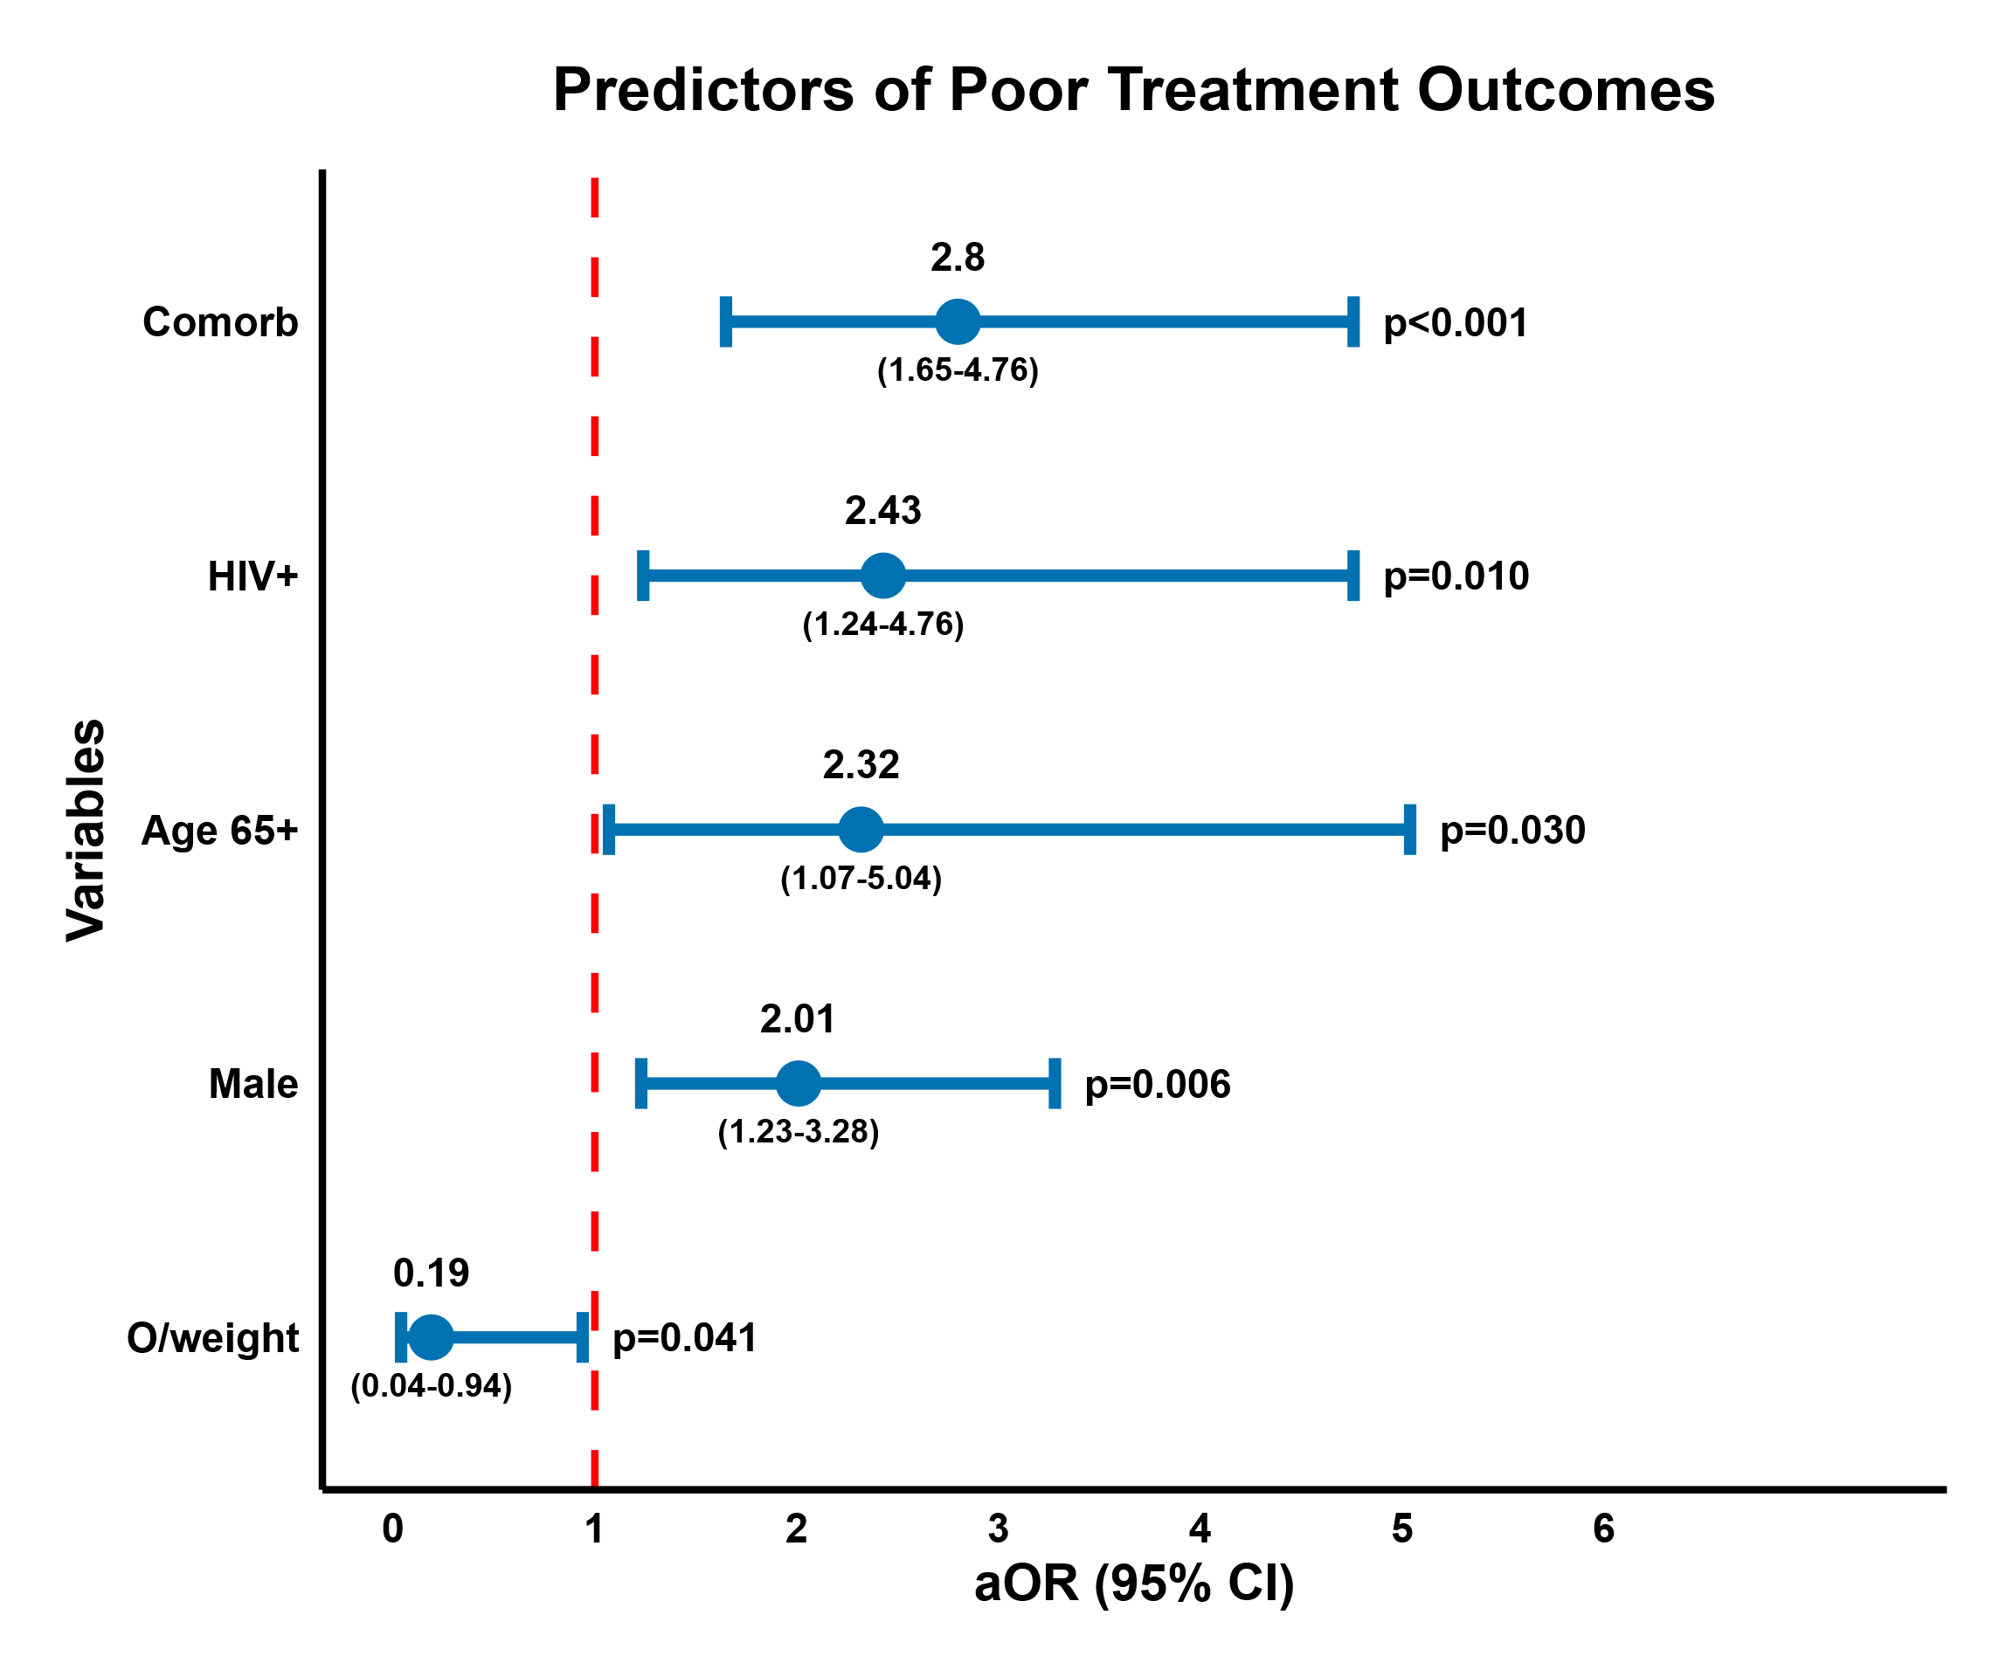
Results: Independent Predictors of PTO, Marsabit, 2019-2024

Slide 10
Discussion
Male sex & older age may reflect adherence challenges and vulnerability (Katana et al., 2022)
HIV & comorbidities increase complexity of TB management, hence poorer outcomes (Ngari et al., 2025; WHO, 2024)
Higher Saku notifications likely reflect diagnostic access and referral effects
Unexpected finding: Protective effect of overweight status reflect better nutritional reserves (Sinha et al., 2025)
Data Strength & Limits: TIBU digital surveillance allowed for high-quality cohort tracking (N=1,897), results rely on secondary data

Slide 11
Conclusion
  Poor outcomes were observed in men, older adults, HIV‑positive, and comorbid cases
  Overweight/obese patients showed a protective effect
  Ending TB in Marsabit requires focus on nutritional resilience

Slide 12
Policy Impact and Implications
  Address poor health-seeking behavior thru’ community-based male engagement sessions & male peer supporters
  Integration of patient care and support (CDH, NCDC, CASCO, CTLC)
  Provide enhanced adherence support using home-based DOT
  Treat nutrition as a core pillar (CNC, CTLC)

Slide 13









Thank you!
Scan to visit our website
#KeHSCon2026
@NPHIKenya
www.nphi.go.ke

